Slide 1
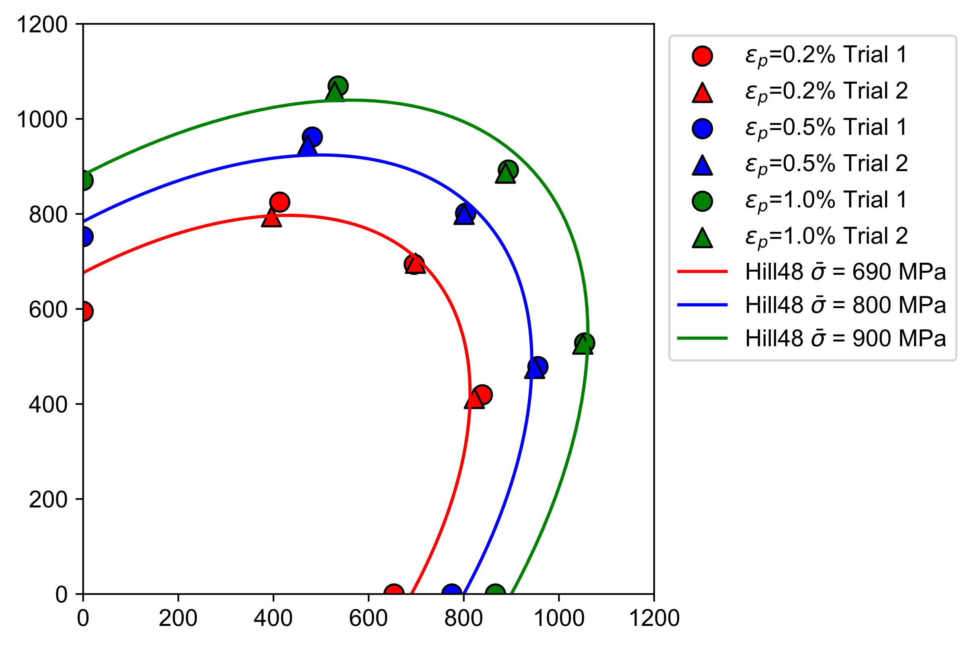
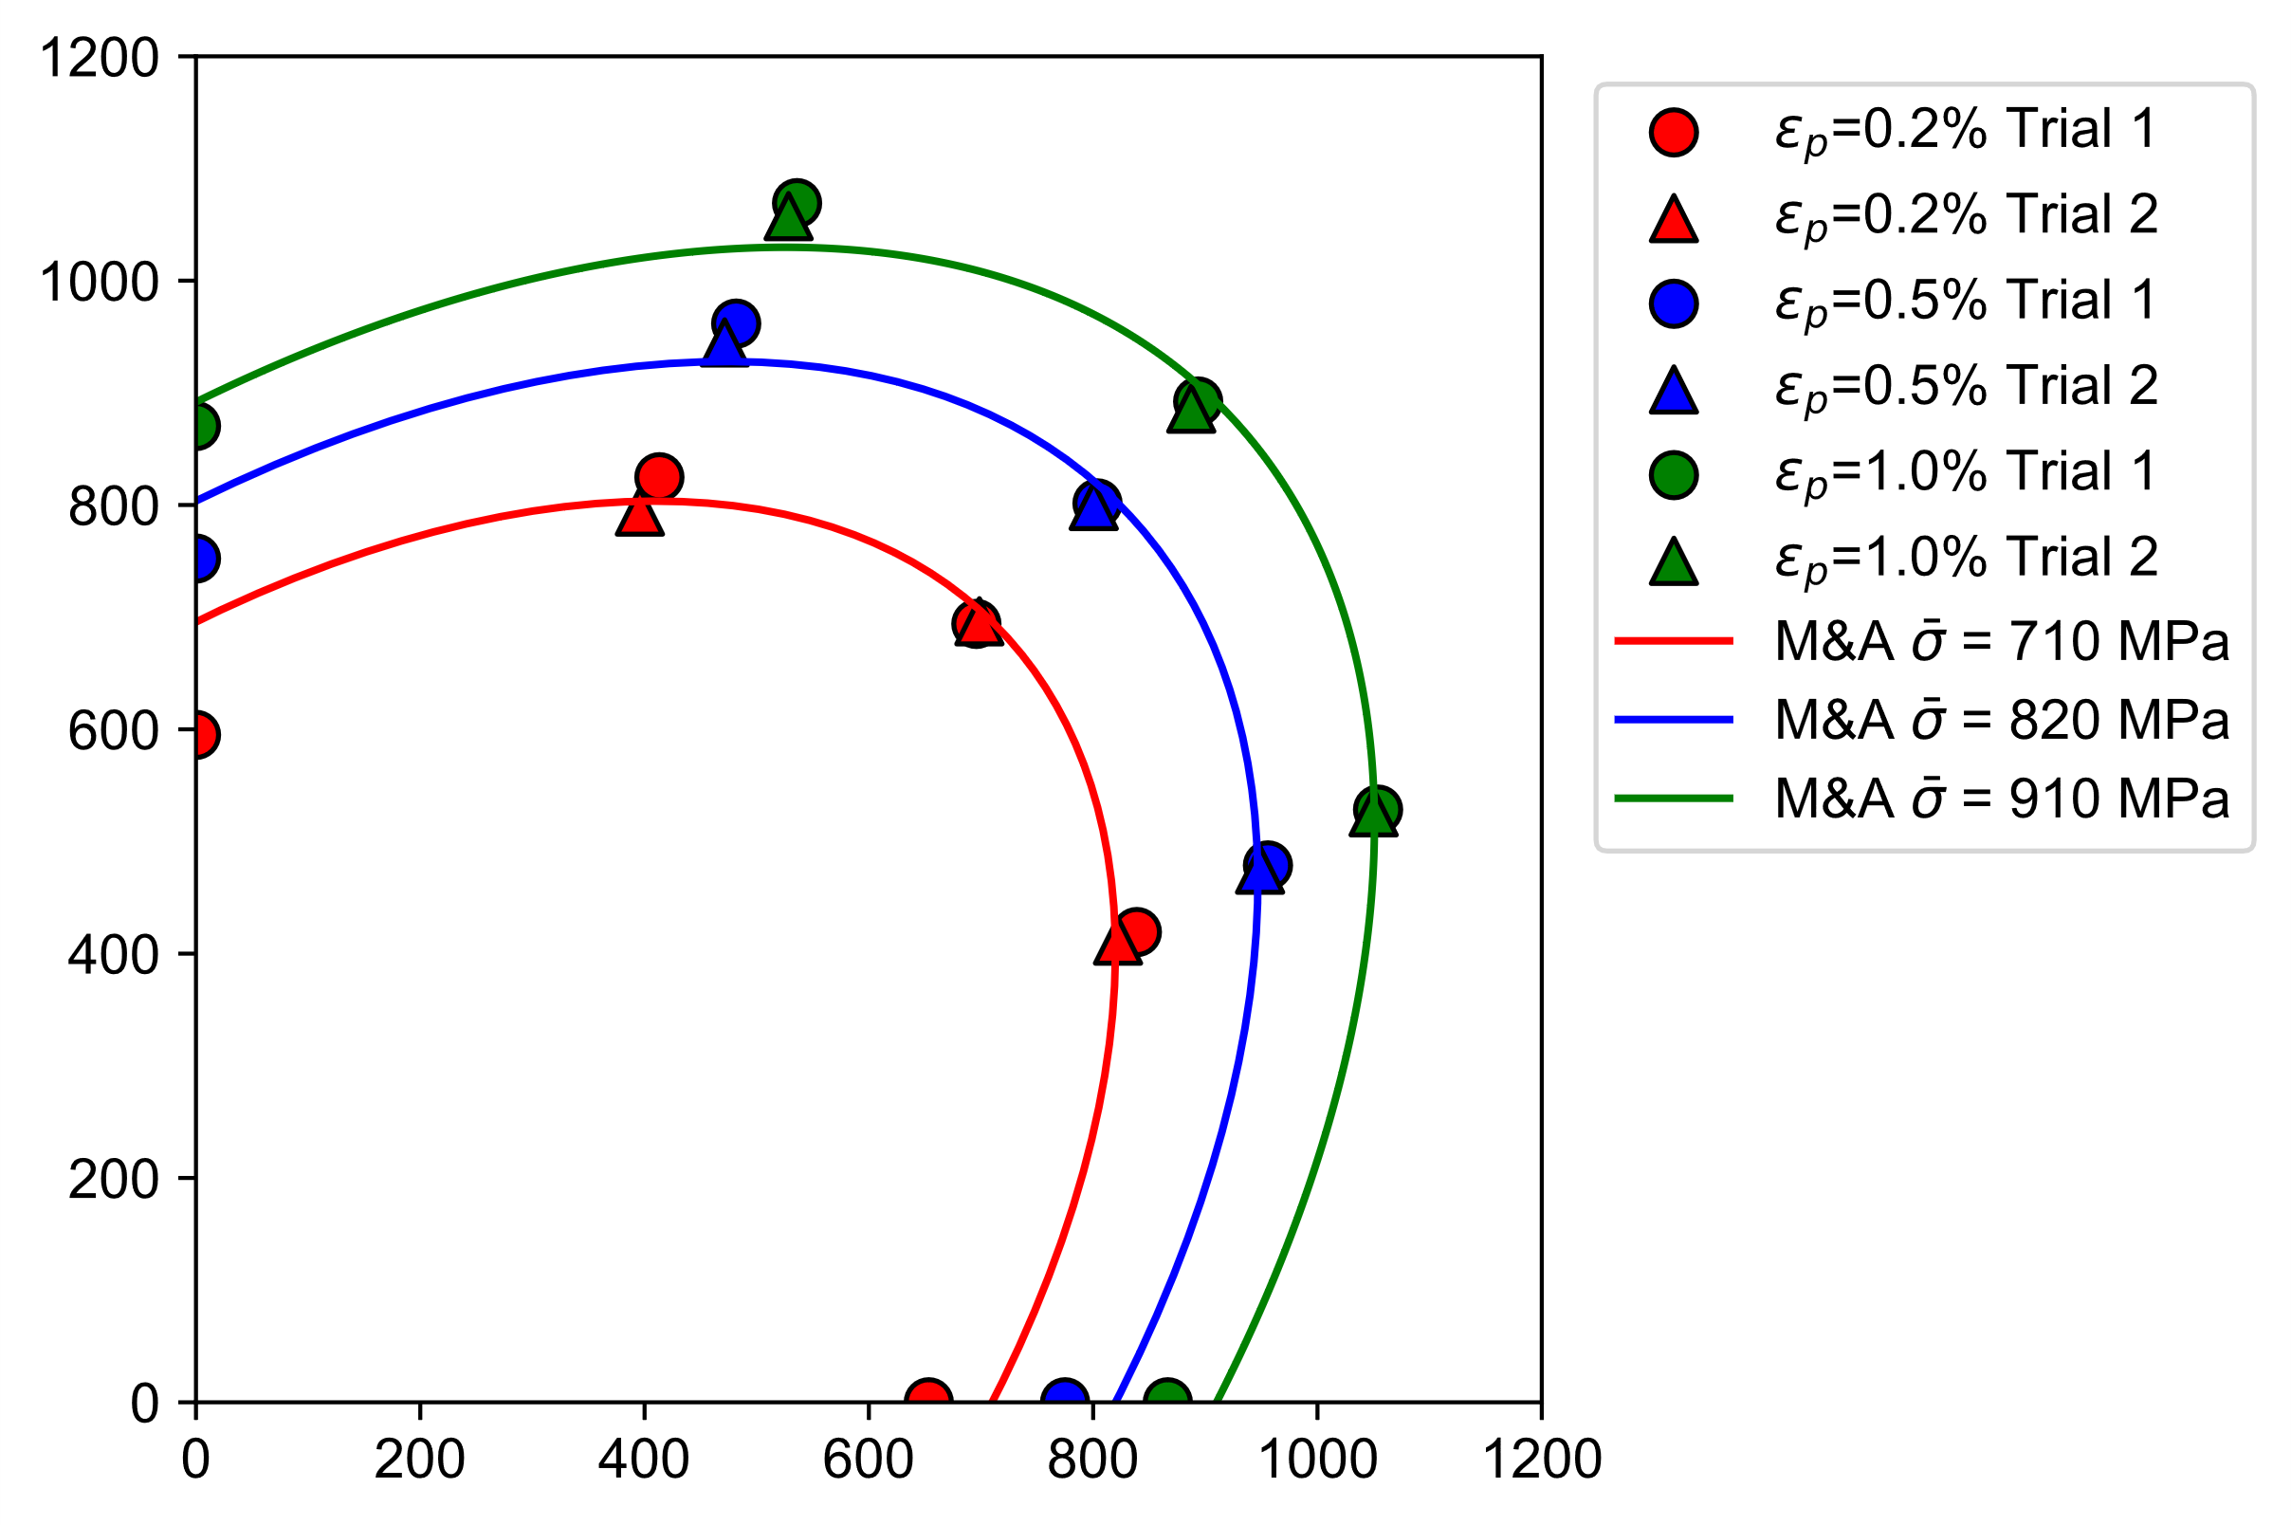
Hill48
M&A quadratic
rx = 1.0
ry = 0.98
rxy = 0.99
rz = 1.0

Slide 2
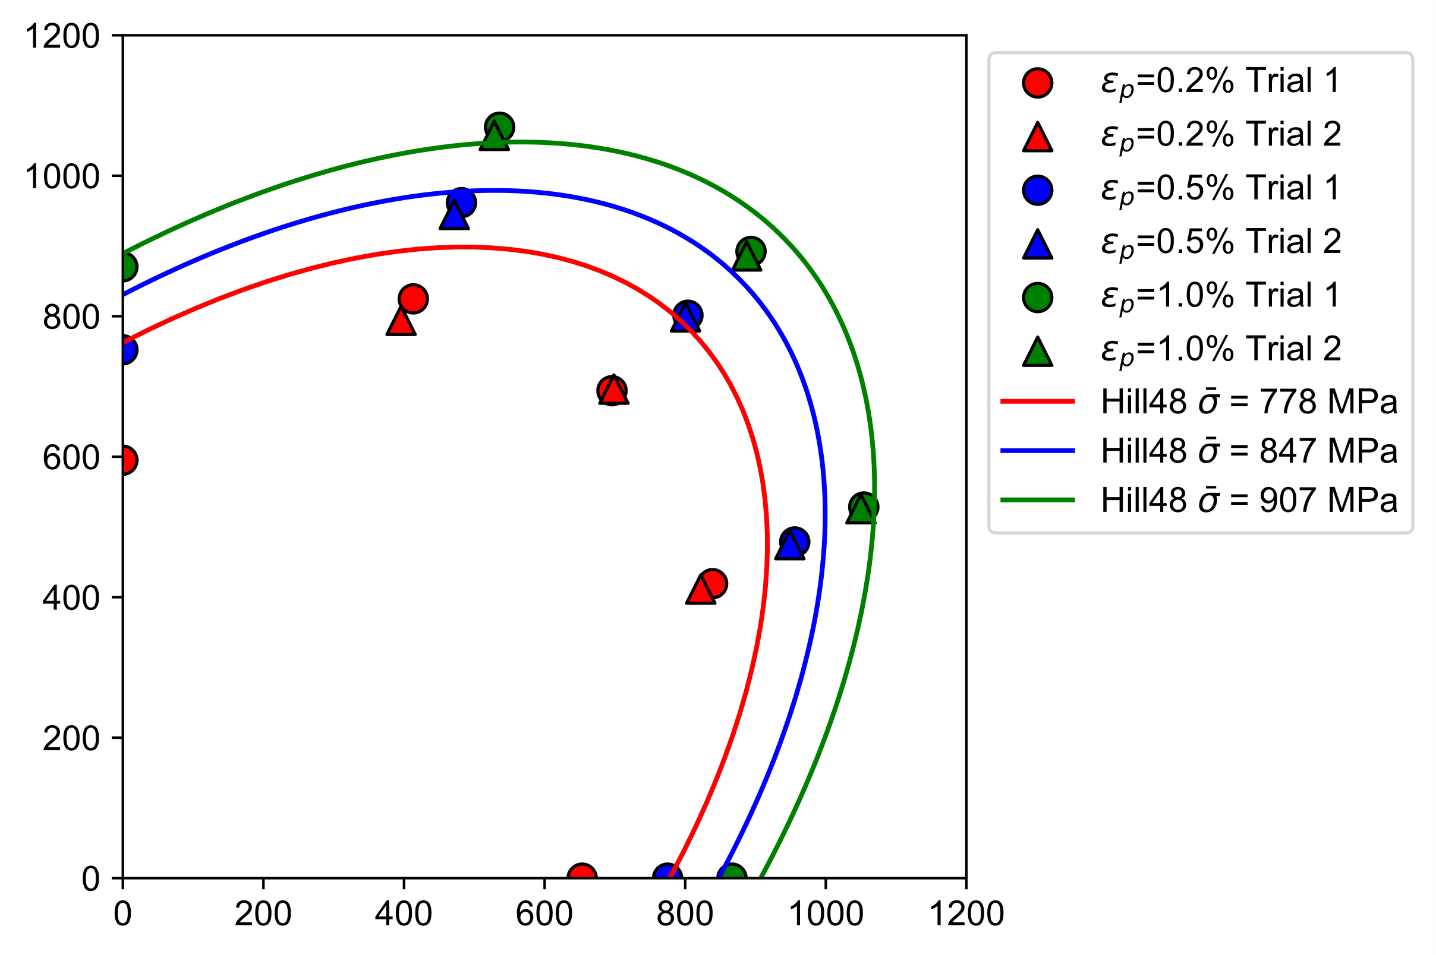
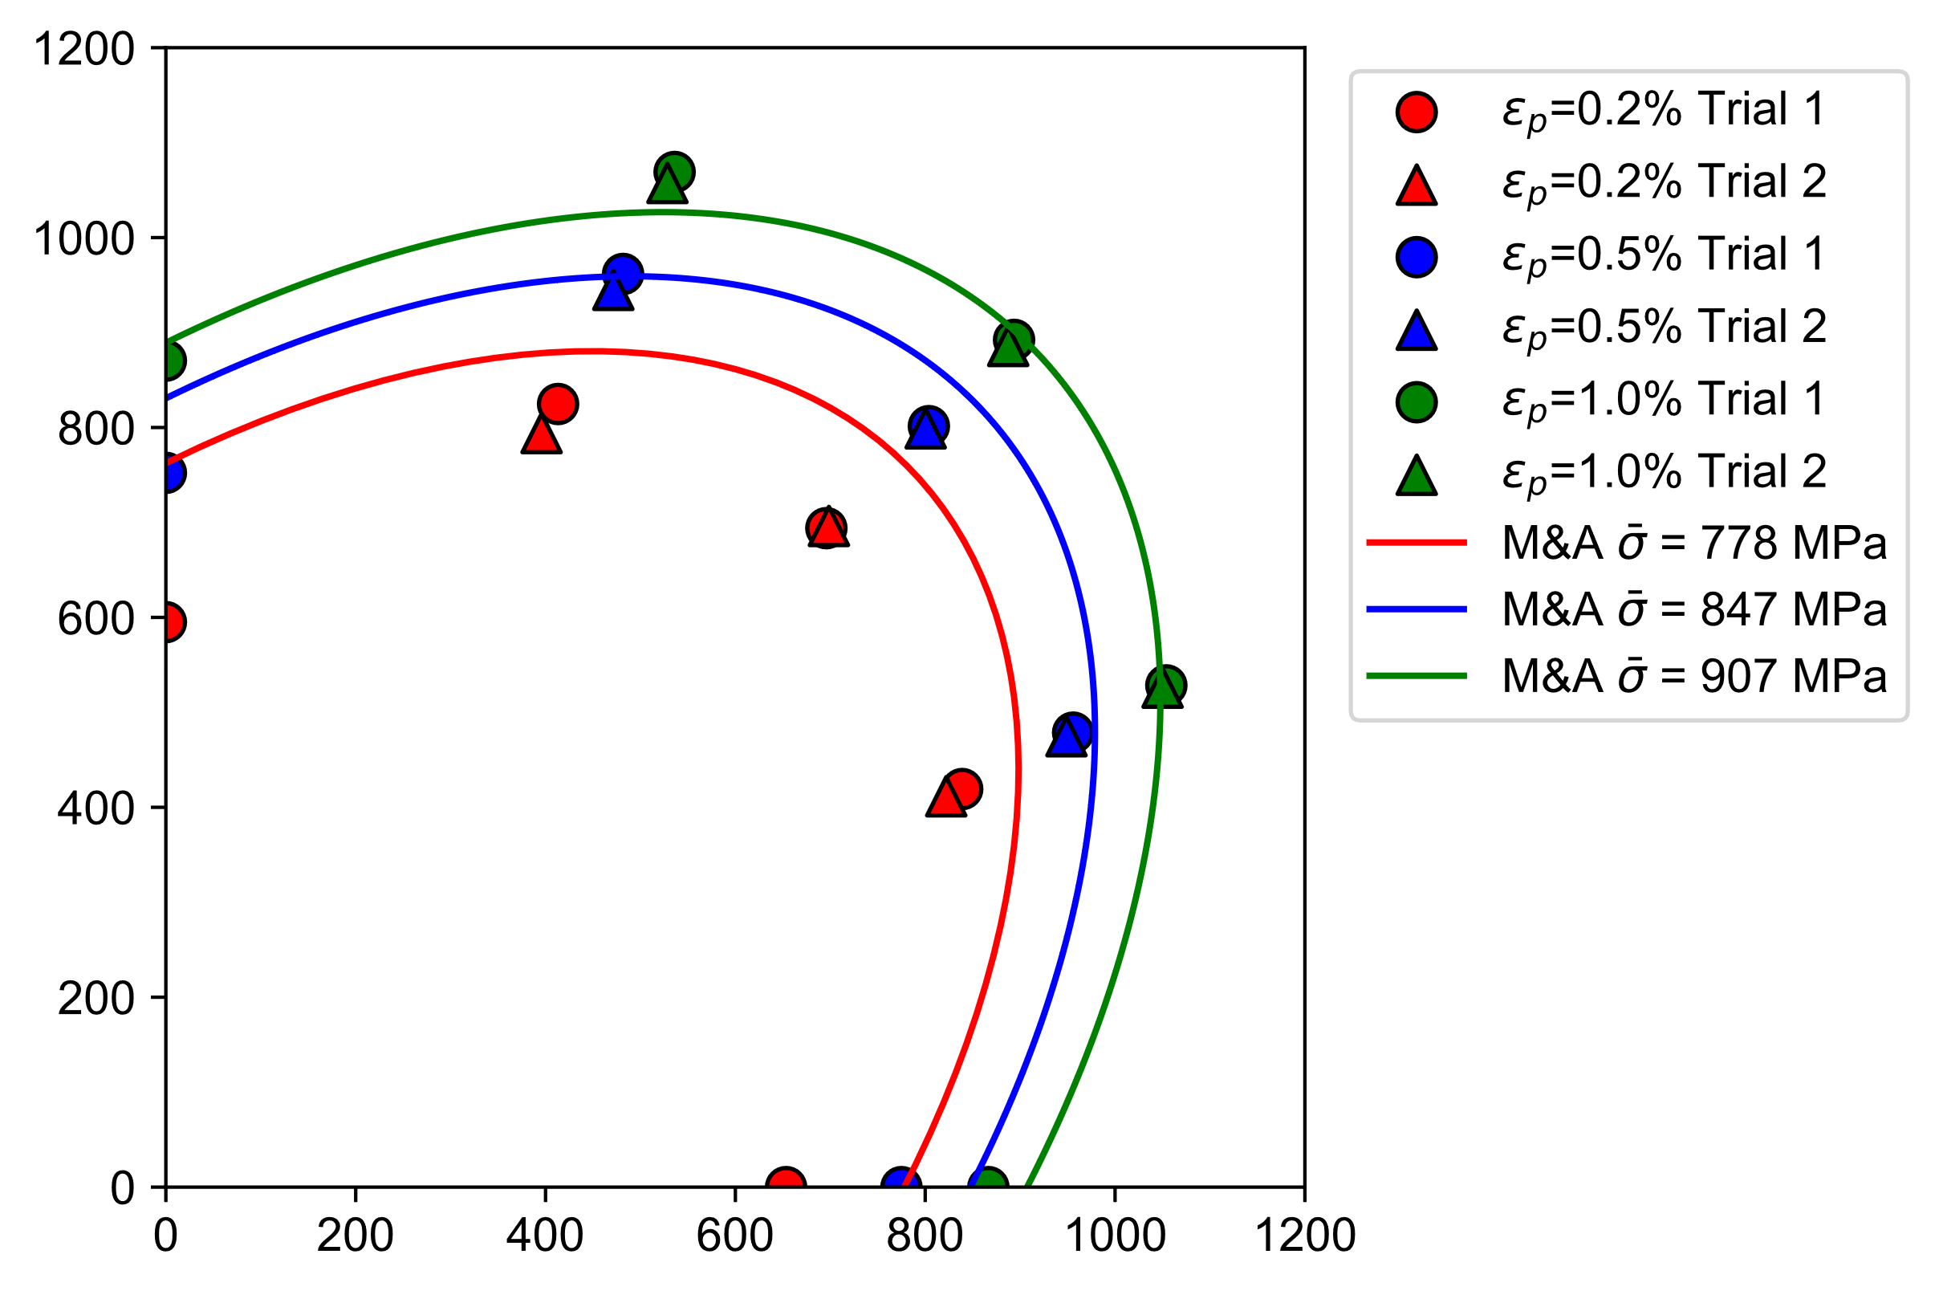
Hill48
M&A quadratic
Equivalent stress calculated from Swift equation

